Slide 1
R toolkit for student retention
By Kim Van Vleet and Mary Donahoo
CSC480 FALL 2019

Slide 2
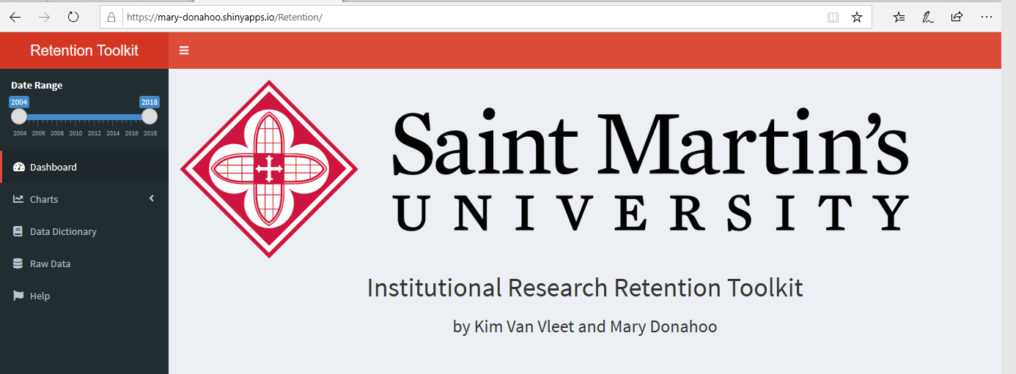
Mid-term Report
https://mary-donahoo.shinyapps.io/Retention/

Slide 3
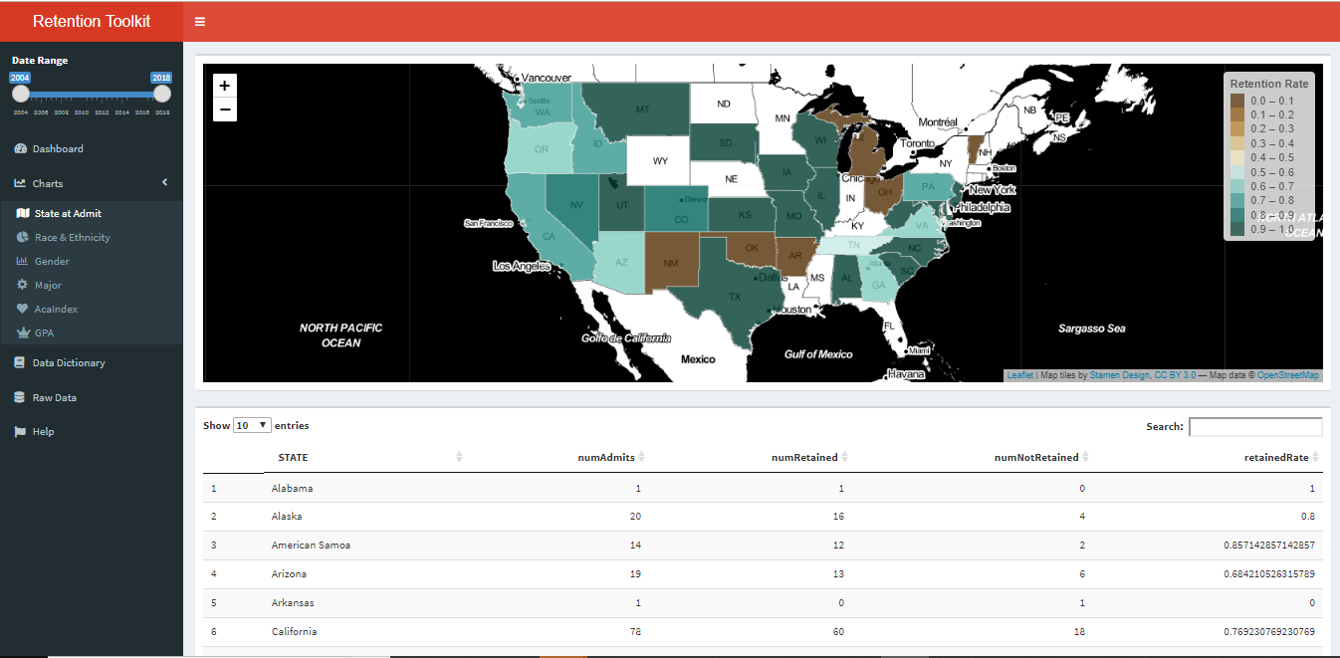
Interactive Leaflet Map

Slide 4
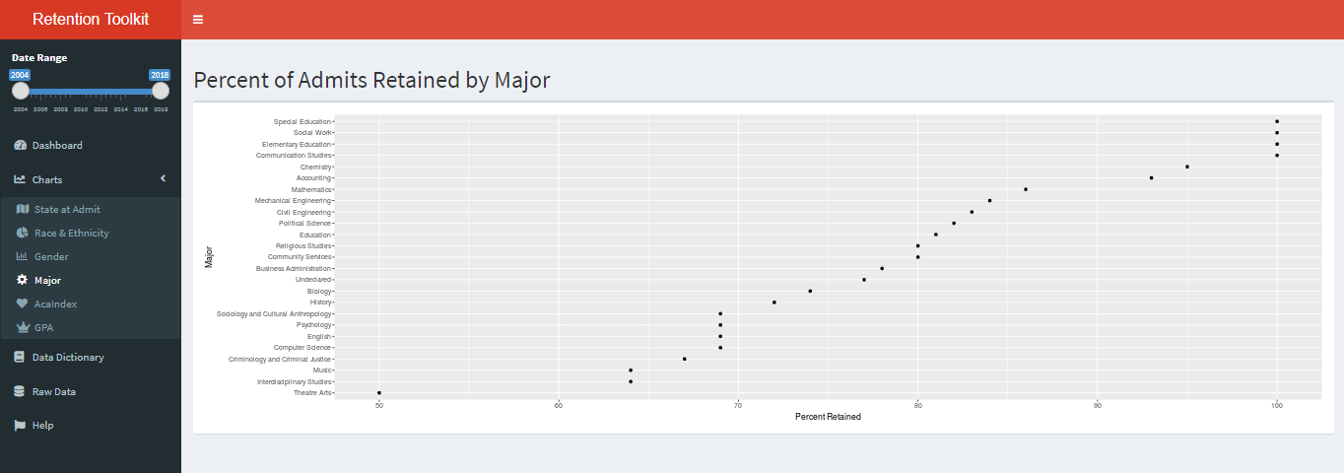
Cleveland Dot Plot

Slide 5
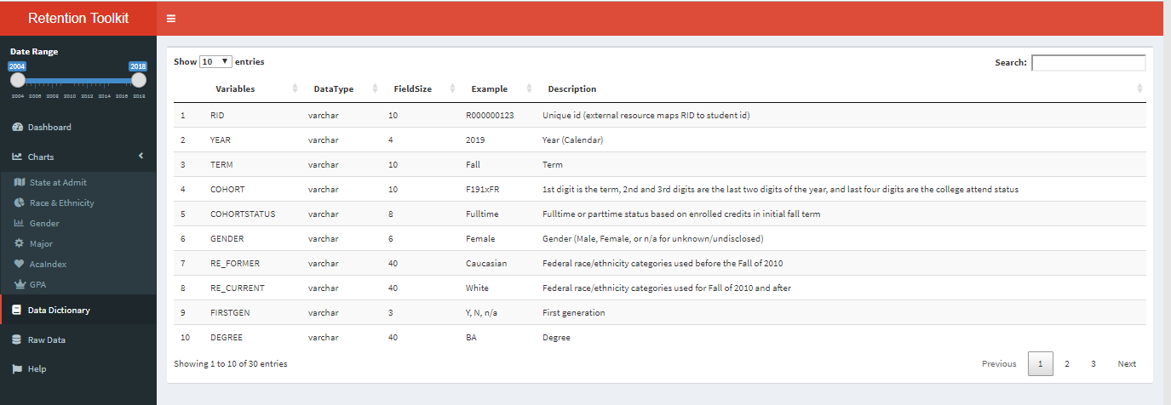
Display data in table - Data Dictionary

Slide 6
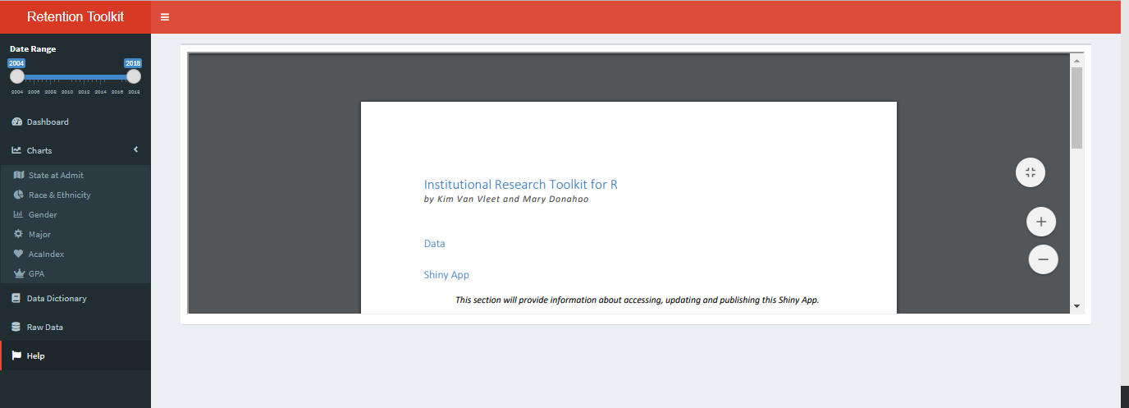
Display PDF document – Help file

Slide 7
End

